Slide 1
Networks Part 1: Naming

Slide 2
Networking = Sharing Info
Humans communicate using 2 basic methods
Speaking
Writing
The methods have rules to make it work smoothly
Speaking: Take turns, raise your hand, no yelling
Writing: Addressing, salutation, punctuation
Network communications have rules too
Finding devices on the network
Making connections
Varies with type of info shared

Slide 3
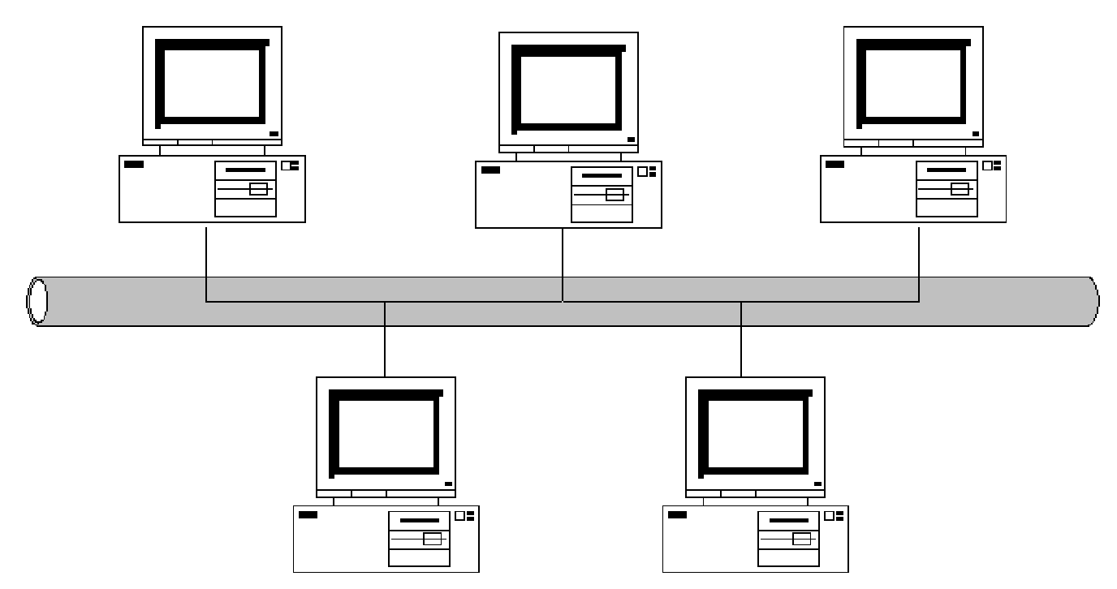
Finding Devices in a Network
Harry
Frank
Sally
?
?
?
?
What are the chances Harry’s message will actually get to Sally?
Joan
Tom
Harry wants to send a message to Sally. But they are not the only users of the cable.

Slide 4

Finding Devices in a Network
MAC Address
Rule #1 – Your device must be unique
an addressing system, a way of uniquely identifying computers and interfaces.
Media Access Control Address
Unique identifier for each networking device
Also known as the physical address of a device
Represented as 12 hex digits
00:24:E8:83:68:96 OR 00-C0-CA-52-38-8C
A MAC address is like a SSN #
Not changeable, unique to you

Slide 5
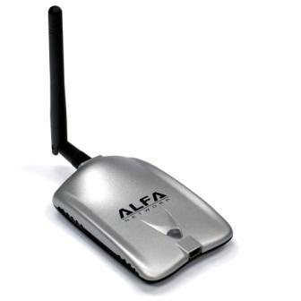
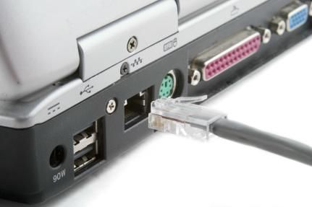
Reading a MAC Address
MAC Address
Device Manufacturer a.k.a Organizational Unique Identifier (OUI)
0
0
C
0
C
A
5
2
3
8
8
C
Assigned by Manufacturer
We can use the MAC address to look up who makes a device
Example: 00-C0-CA = Alfa & 00:24:E8 = Dell

Slide 6
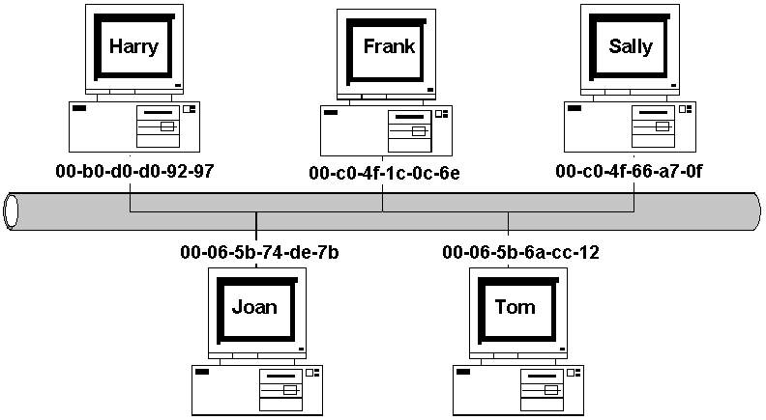
Finding Devices in a Network
With MAC addresses, we can uniquely identify each device or interface on the network.
Alert – Mac Address can be spoofed!

Slide 7
Finding Devices in a Network
IP Address
Rule #2 – You must “belong” to a network
Joining a network provides you with lots of cool stuff:
Access to shared files
Access to devices like printers or scanners
Access to Internet Service Providers
When you join a network you become connected
Great! How do I join?! Get an IP Address

Slide 8
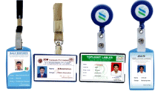
IP address
Internet Protocol Address
TEMPORARY identifier for each interface
Must be unique among the connected devices on that network
An IP address is like an ID card
Changeable
Can belong to many organizations
Unique within that organization

Slide 9
IP Address
2 types of IP addresses
IPv4: Old, but still the most commonly used.
32 bits represented in 4 sections separated by dots. Each section can hold a decimal number from 0 to 255.
Example: 192.168.55.32
IPv6: New, the world is trying to convert slowly to this.
128 bits represented in 8 sections separated by colons. Each section can hold a hexadecimal number from 0000 to FFFF.
Example: 2001:0DB8:0000:0000:0008:8000:0000:417A
IPv6 can be shortened to things like:
2001:DB8:0:0:8:8000:0:417A
2001:DB8::8:8000:0:417A
Switching because we’ve run out of IPv4 addresses
IPv4 max 4,294,967,296 (2³⁶) addresses
IPv6 max 340,282,366,920,938,463,463,374,607,431,768,211,456 (2¹²⁸) addresses
Notes:
IPV4 is being changed to IPV6 because the world has run out of unique addresses. IPv4 had a maximum number of 4,294,967,296 addresses (2³²).
IPv6 will have 340,282,366,920,938,463,463,374,607,431,768,211,456 addresses (2¹²⁸) (Link to article on how big that number is and how to pronounce it! - http://itknowledgeexchange.techtarget.com/whatis/ipv6-addresses-how-many-is-that-in-numbers/).
IPV6 can be shortened in a lot of ways so don’t be confused if you see the above address as:
2001:DB8:0:0:8:8000:0:417A
2001:DB8::8:8000:0:417A
2001:DB8:0:0:8:8000::417A
2001:db8::8:8000:417A

Slide 10

IPv4 Address
Can be Public or Private
Private
An address series that can be used in many orgs
Address can begin with: 10 or 172.16 – 172.31 or 192.168
Must ‘piggyback’ on a public address to get to the Internet → this is called NAT (Network Address Translation)
Public
The addresses are unique in the entire world
Must be used to go on the Internet
There aren’t any more IPv4 public addresses
Notes:
IP addressing and NAT (Network Address Translation) are topics with lots of depth. For this presentation the objective is to achieve minimal understanding of how these settings affect connectivity.

Slide 11
Getting an IP Address
You can get an IP address statically
Add the IP address yourself to your device
Stays the same unless you change it
Servers, website hosting, etc.
You can get an IP address dynamically
Network server assigns you an IP address automatically
This is called DHCP (Dynamic Host Configuration Protocol)
More secure because address changes each time you log on
Every time your device joins a new network, it will get a new IP address.
Home network - could be 192.168.1.54
School network - could be 10.0.1.37
Starbucks network - could be 192.168.0.11
IP and MAC addresses work together
Notes:
To configure IP address on a Windows device: 1. Start → in the bottom search field enter “network connections” → click on the top selection “View Network Connections” then click on the interface you want to configure.
Scroll down to select Internet Protocol Version 4 (TCP/IPv4), then click Properties
Here you will be able to select dynamic IP address = “Obtain an IP address automatically” OR If you know the IP address that will allow you to join your network, you can select “Use the following address”

Slide 12
Find a Device = ARP
To send data, a device must know BOTH the IP and the MAC address of the receiving device.
ARP (Address Resolution Protocol) is a tool used by devices on the same network to find the MAC address associated with an IP address
One device broadcasts an ARP request to all the devices on the network. It’s sort of like yelling to see if you can find someone.
The device with the particular IP address responds with its MAC address.

Slide 13
How ARP works
Hey, everybody! Who is 10.0.0.1?
Bob
I am!!!
A1:FF:32:5A:EC:AA
10.0.0.3 C0:43:1E:00:57:D3
Sally
Ok – I’ll put that in my ARP table
Internet address | Physical address
10.0.0.1 | A1:FF:32:5A:EC:AA

Slide 14
Finding Devices in a Network
FQDN
There is one naming method for computers that is “human readable”
FQDN (Fully Qualified Domain Name)
Format: host.yourdomain.top-leveldomain
Top-level domain: .com, .net, .edu, .gov, .org, (etc.)
Examples: help.ubuntu.com
www.yahoo.com
A data packet is delivered by mapping a FQDN to it’s IP address and then to it’s MAC address
www.google.com > 8.8.8.8 > Magic

Slide 15
Activity #1 Finding your computer names

Slide 16

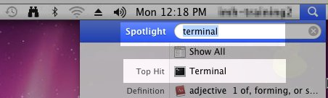
Using the Terminal
To open the terminal in Windows
Start > cmd > Enter
To open the terminal in Mac
Spotlight | terminal → Enter

Slide 17
TCP/IP tools
Try it!
You will be using these terminal commands:
Command | What info it provides
ifconfig -a | MAC address, IPc4, IPv6, other things
ping | Can I successfully connect to a certain device?
arp | What is the MAC address of devices I previously have connected to?
nslookup | IP address of a FQDN
Notes:
nslookup google.com

